Slide 1

Identifying the brand of ammunition from gunshot residue
Dominic Davis-Foster
MSci Forensic Science
Staffordshire University

Slide 2
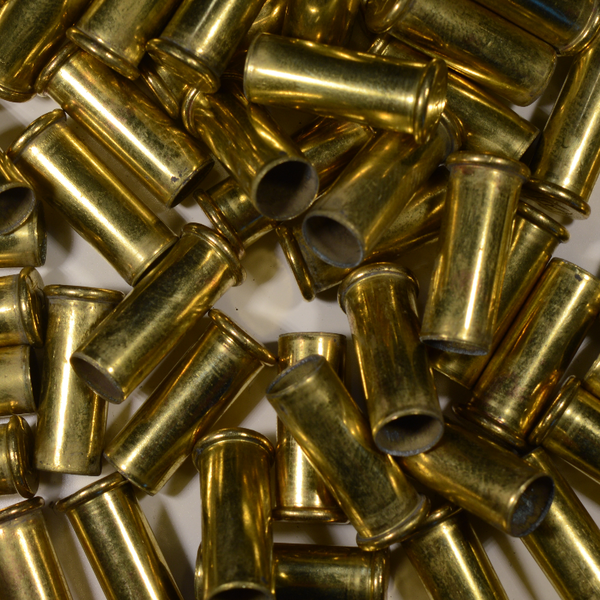
Outline of presentation
What is Gunshot Residue?
.22 Long Rifle and its use in crime
Chemical Analysis
Data Analysis
Results
Further Work
Notes:
(0) I’m going to cover:
(1) What gunshot residue is
(2) .22 Long Rifle and its use in crime
(3) The chemical analysis and data analysis carried out
(4) The results I obtained, and further work that can be carried out.

Slide 3
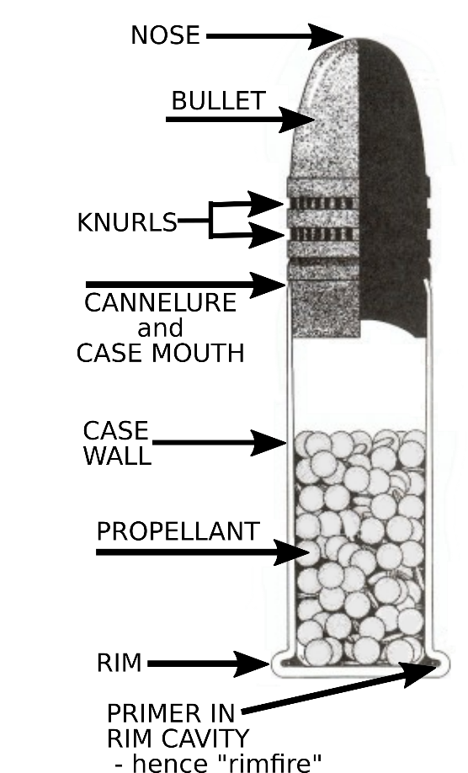
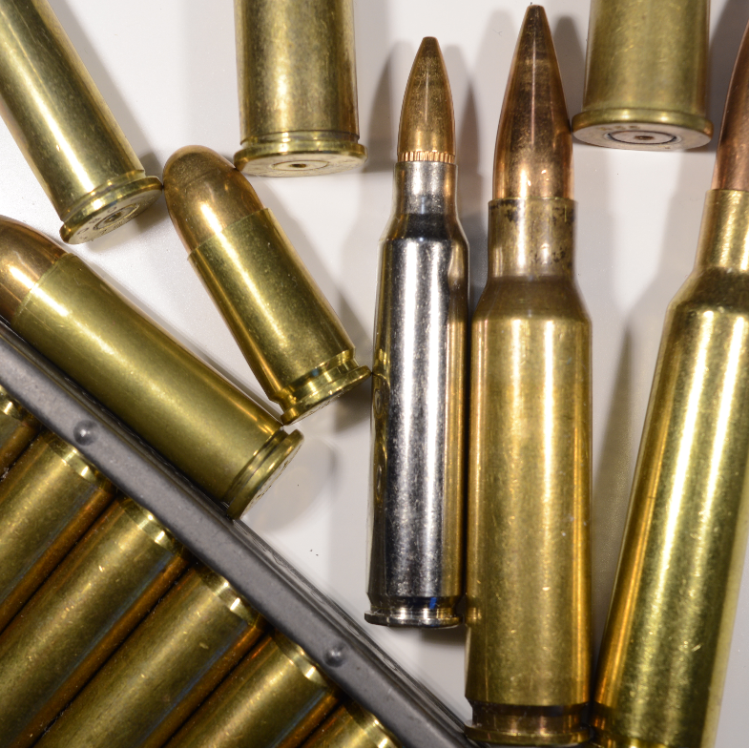
Gunshot Residue
GSR consists of organic and inorganic compounds from the primer and propellant
Organic compounds include:
Diphenylamine (DPA)
Ethyl Centralite (EC)
2,4-Dinitrotoluene (DNT)
Dibutyl Phthalate (DBP)
Camphor
Nitroglycerine (NG)
Only in “double base” propellants
Notes:
(1) When a gun is fired a firing pin strikes the primer <point> and causes it to detonate. This results in combustion of the propellant <point>, which propels the bullet <point> down the barrel.
(2) Gunshot residue consists of organic and inorganic (metallic) compounds from the primer and propellant.
(3) Organic compounds include:
Diphenylamine (DPA)
Ethyl Centralite (EC)
2,4-Dinitrotoluene (DNT)
Dibutyl Phthalate (DBP)
Camphor
Nitroglycerine (NG)
These compounds perform various functions within the propellant
GSR also contains breakdown products of these compounds.
(4) Propellants containing nitroglycerine are called “Double base”. Propellants without it are called “single base”
Firearm propellant is also used in improvised explosive devices
Wallace, 2008; Mach, Pallos and Jones, 1978
Image from ELEY Ltd, 2014

Slide 4
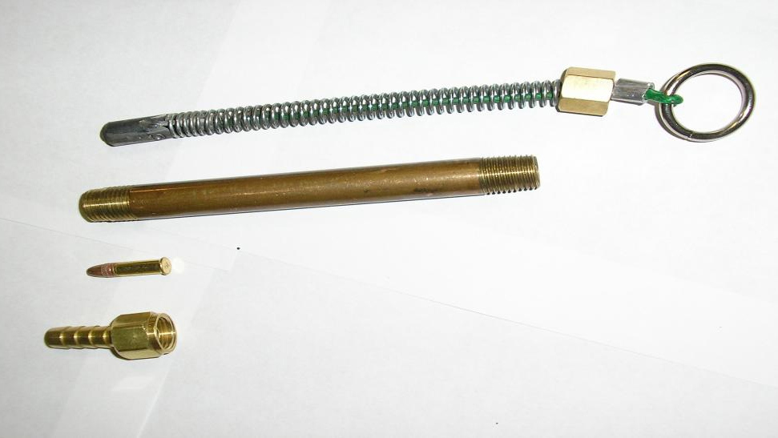

.22 Long Rifle
.22 Long Rifle cartridges popular with target shooters
Also used by criminals
Shooting of MP Jo Cox (2016)
Cumbria Shootings (2010)
Most research so far has focused on handgun ammunition
© 2016 The Firearm Blog
$5 improvised .22 LR firearm.
Notes:
.22 Long Rifle cartridges are popular with target shooters and hunters,…
(2) …but are also used by criminals.
Notable cases include (3) the shooting of MP Jo Cox in 2016, (4) and the Cumbria shootings in 2010
(5) .22 LR ammunition is also used by criminals in some improvised weapons, such as this $5 firearm made with parts from a hardware store <show example>
(6) Most research so far has focused on handgun ammunition. There has only been limited research into .22 LR ammunition
Image from http://www.thefirearmblog.com/blog/2016/12/19/hardware-store-zip-guns/

Slide 5
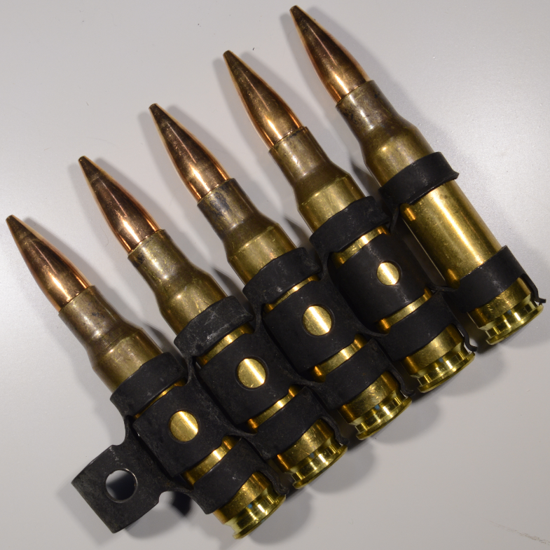
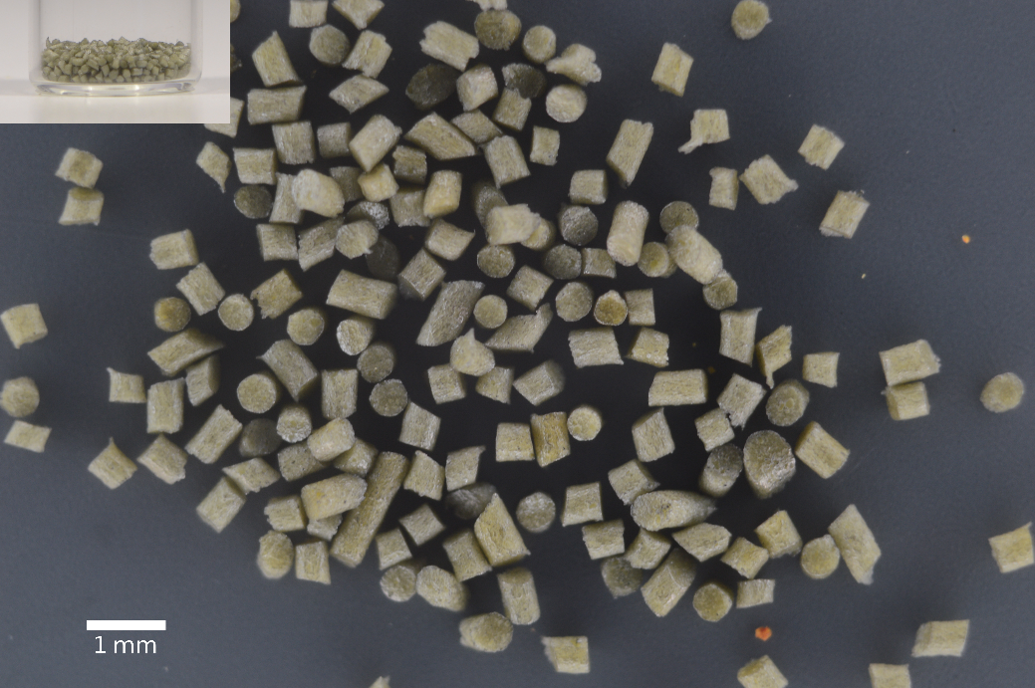
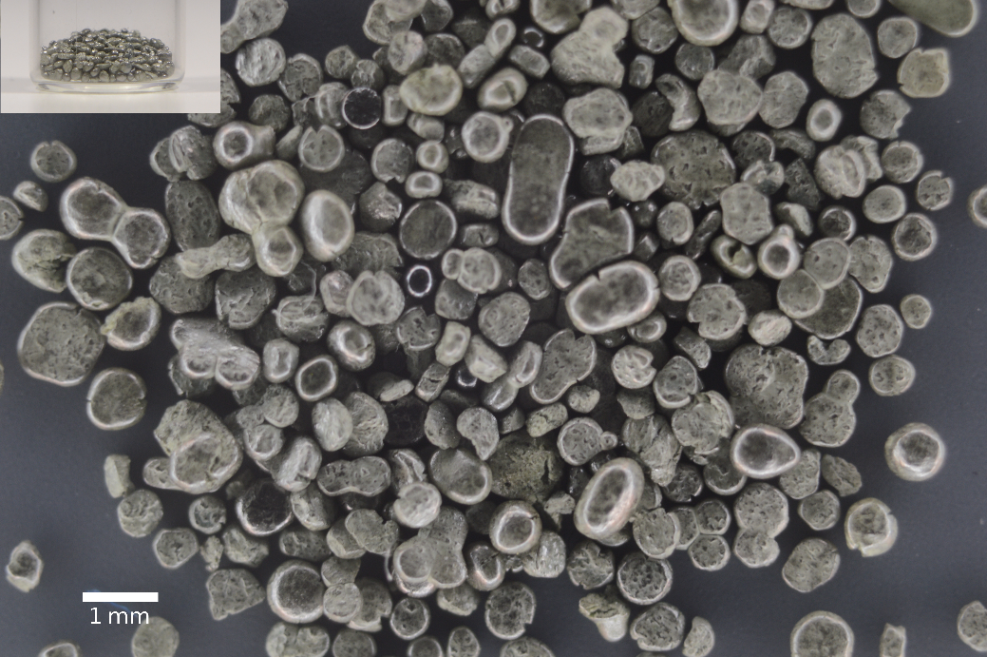
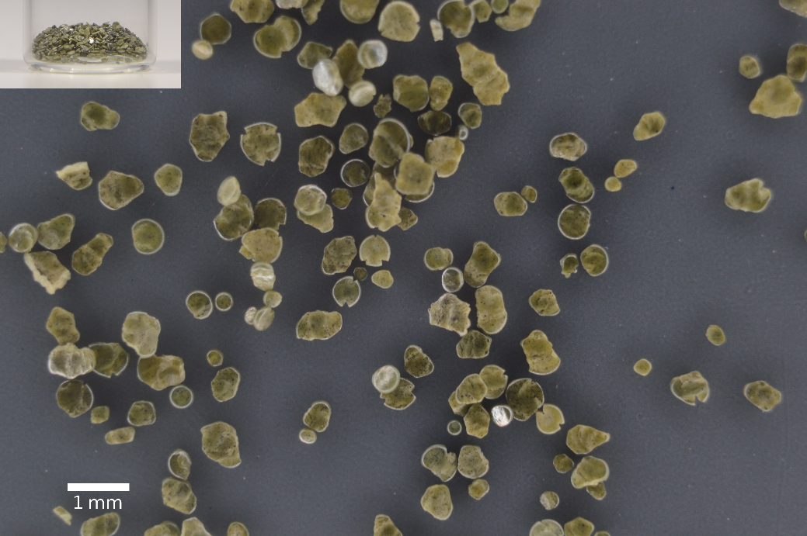
Methods
Three brands: Eley Contact, Winchester Pistol, Geco Rifle
10 cartridges fired and collected for GSR
Propellant collected from 6 cartridges
Eley Contact
Winchester Pistol
Geco Rifle
Notes:
Three brands of .22 LR cartridges were analysed: Eley Contact, Winchester Pistol, and Geco Rifle.
10 cartridges of each brand were fired and the cartridge cases placed in 4 mL GC vials.
A further 6 cartridges were disassembled and the propellant collected into 2 mL GC vials
(4) The Eley Contact propellant consists of pale green cylinders, about 0.5mm in diameter and between 0.5 and 1.5mm long
(5) The Winchester Pistol propellant consists of light grey flattened balls, about 0.4mm in diameter, and irregular flakes, about 1.17mm in diameter
(6) The Geco Rifle propellant consists of olive green flattened balls, about 0.42mm in diameter, and irregular flakes, about 0.67mm in diameter
The three propellants can be distinguished based on their colour and shape alone, but the question is: do they have different chemical compositions, and do they produce chemically different GSR?

Slide 6
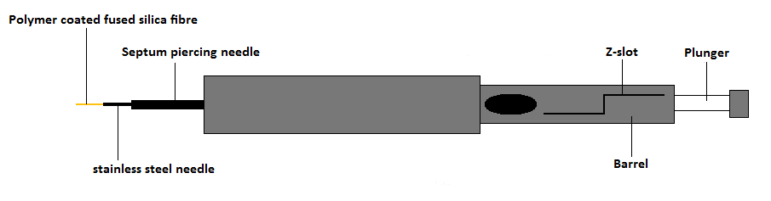
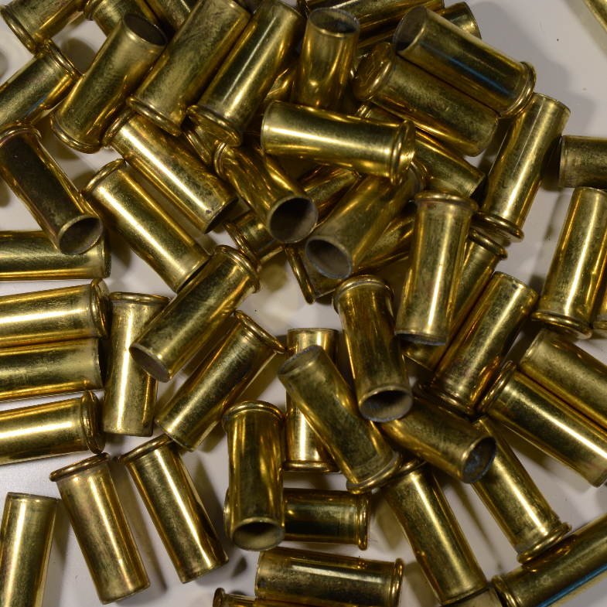
Methods
Samples heated in oven for 45 minutes at 80ºC
Compounds diffuse from headspace of vial onto SPME fibre coating
SPME Fibre Assembly (Dalby, 2011)
Notes:
(0) Analysis was carried out by headspace-SPME-GC-MS
(1) The vials containing unfired propellant or fired cartridge cases were placed in an oven at 80ºC for 45 minutes with an SPME fibre inserted
(2) The volatile compounds in the propellant or GSR are adsorbed onto the SPME fibre’s coating
(3) <briefly explain fibre assembly>

Slide 7
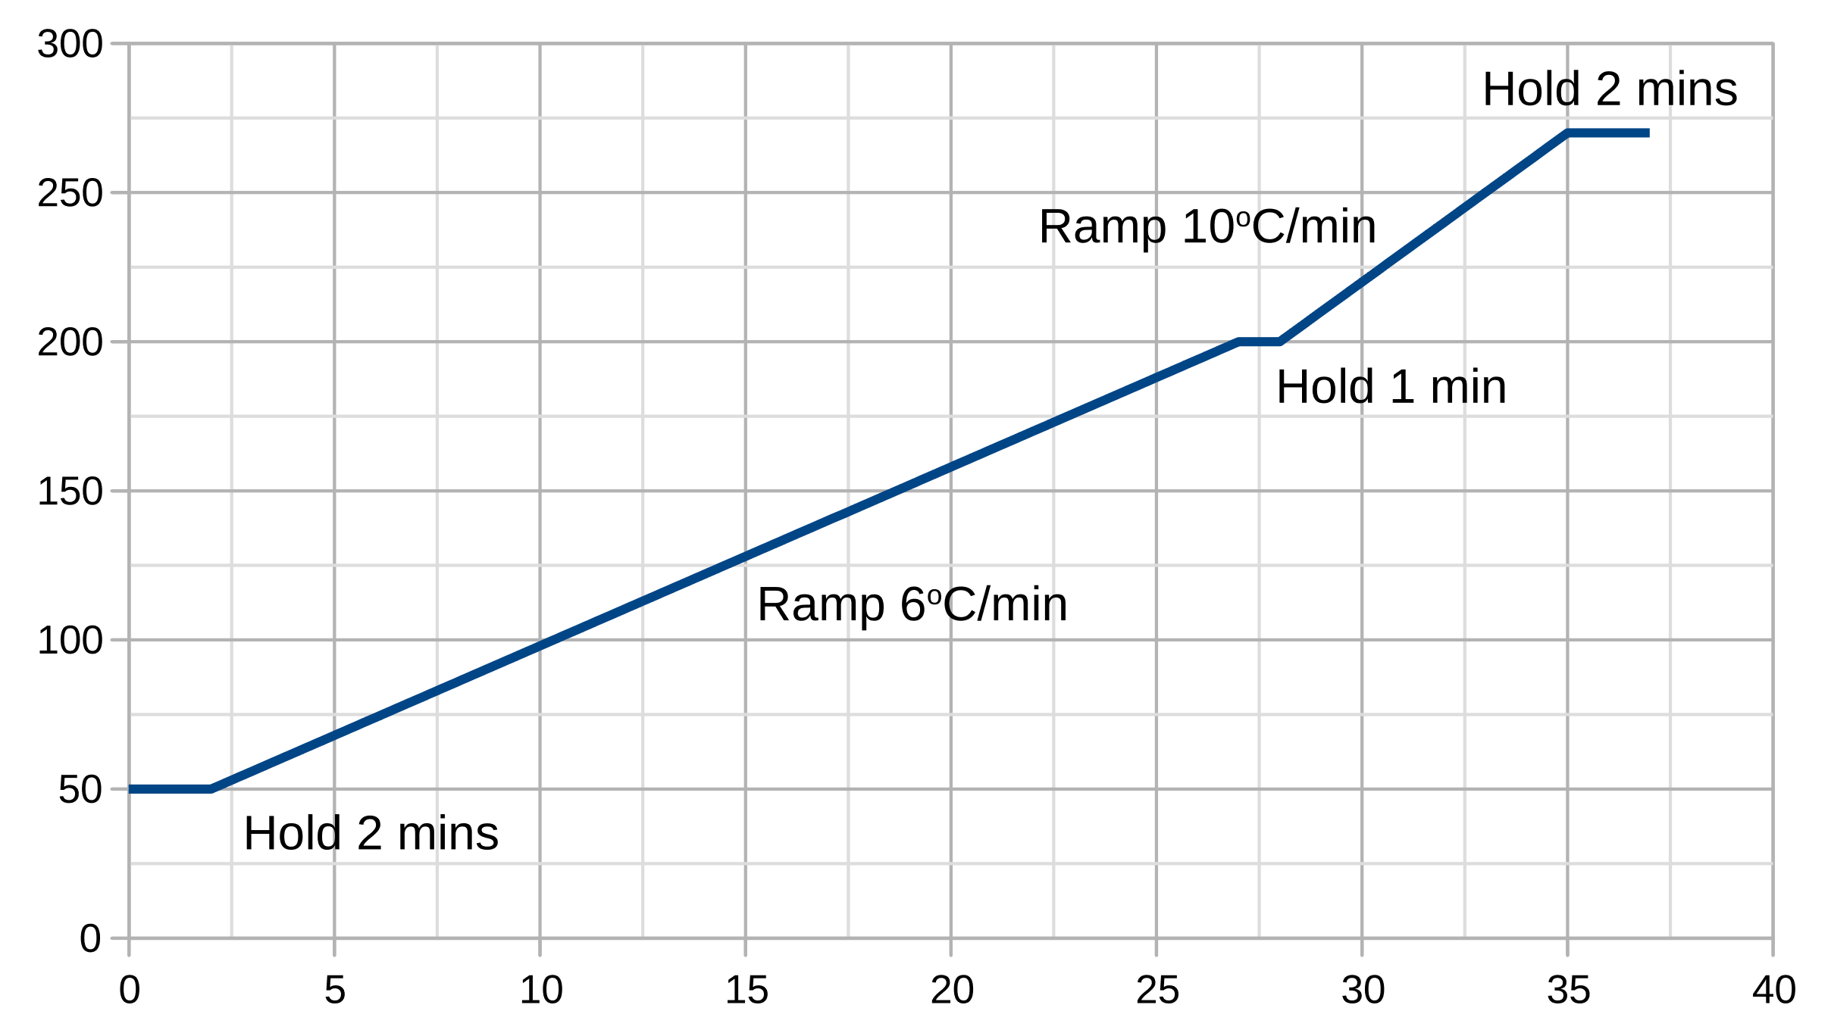
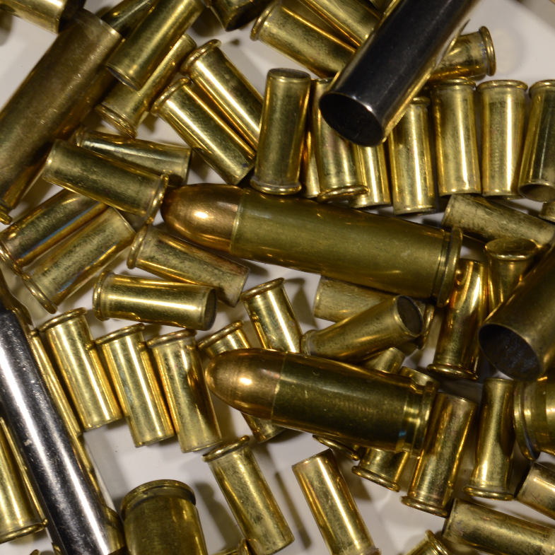
Methods
Compounds identified by GC-MS
Based on methods by Dalby (2011) and Wilson, Tebow and Moline (2003)
Gas Chromatography Temperature Program
Notes:
The SPME is fibre inserted into the GS-MS to identify the compounds present and their concentrations
The analysis is based on existing methods by Dalby (2011) and Wilson, Tebow and Moline (2003)
<briefly explain temperature program>

Slide 8
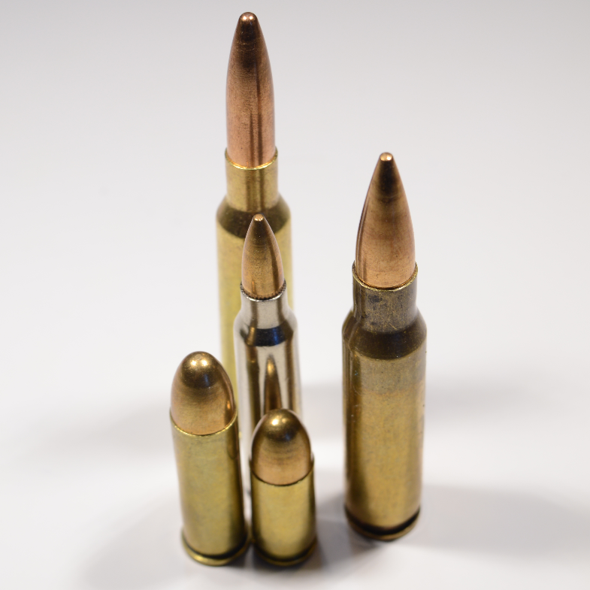
Methods
Bespoke, automatic analysis program developed in Python to process results
Generates a “profile” for the components present in propellants
Profile can be compared to other propellants and GSR samples
Notes:
A bespoke, automatic analysis program called “GunShotMatch” was developed in Python to process the results.
(2) The compounds identified by GC-MS analysis vary slightly between different samples of the same propellant, but “GunShotMatch” can determine the compounds that are in common between 5 (or more) repeat analyses to produce a “profile” for the propellant
(3) “GunShotMatch” can also compare the profiles generated for propellants and GSR samples.

Slide 9
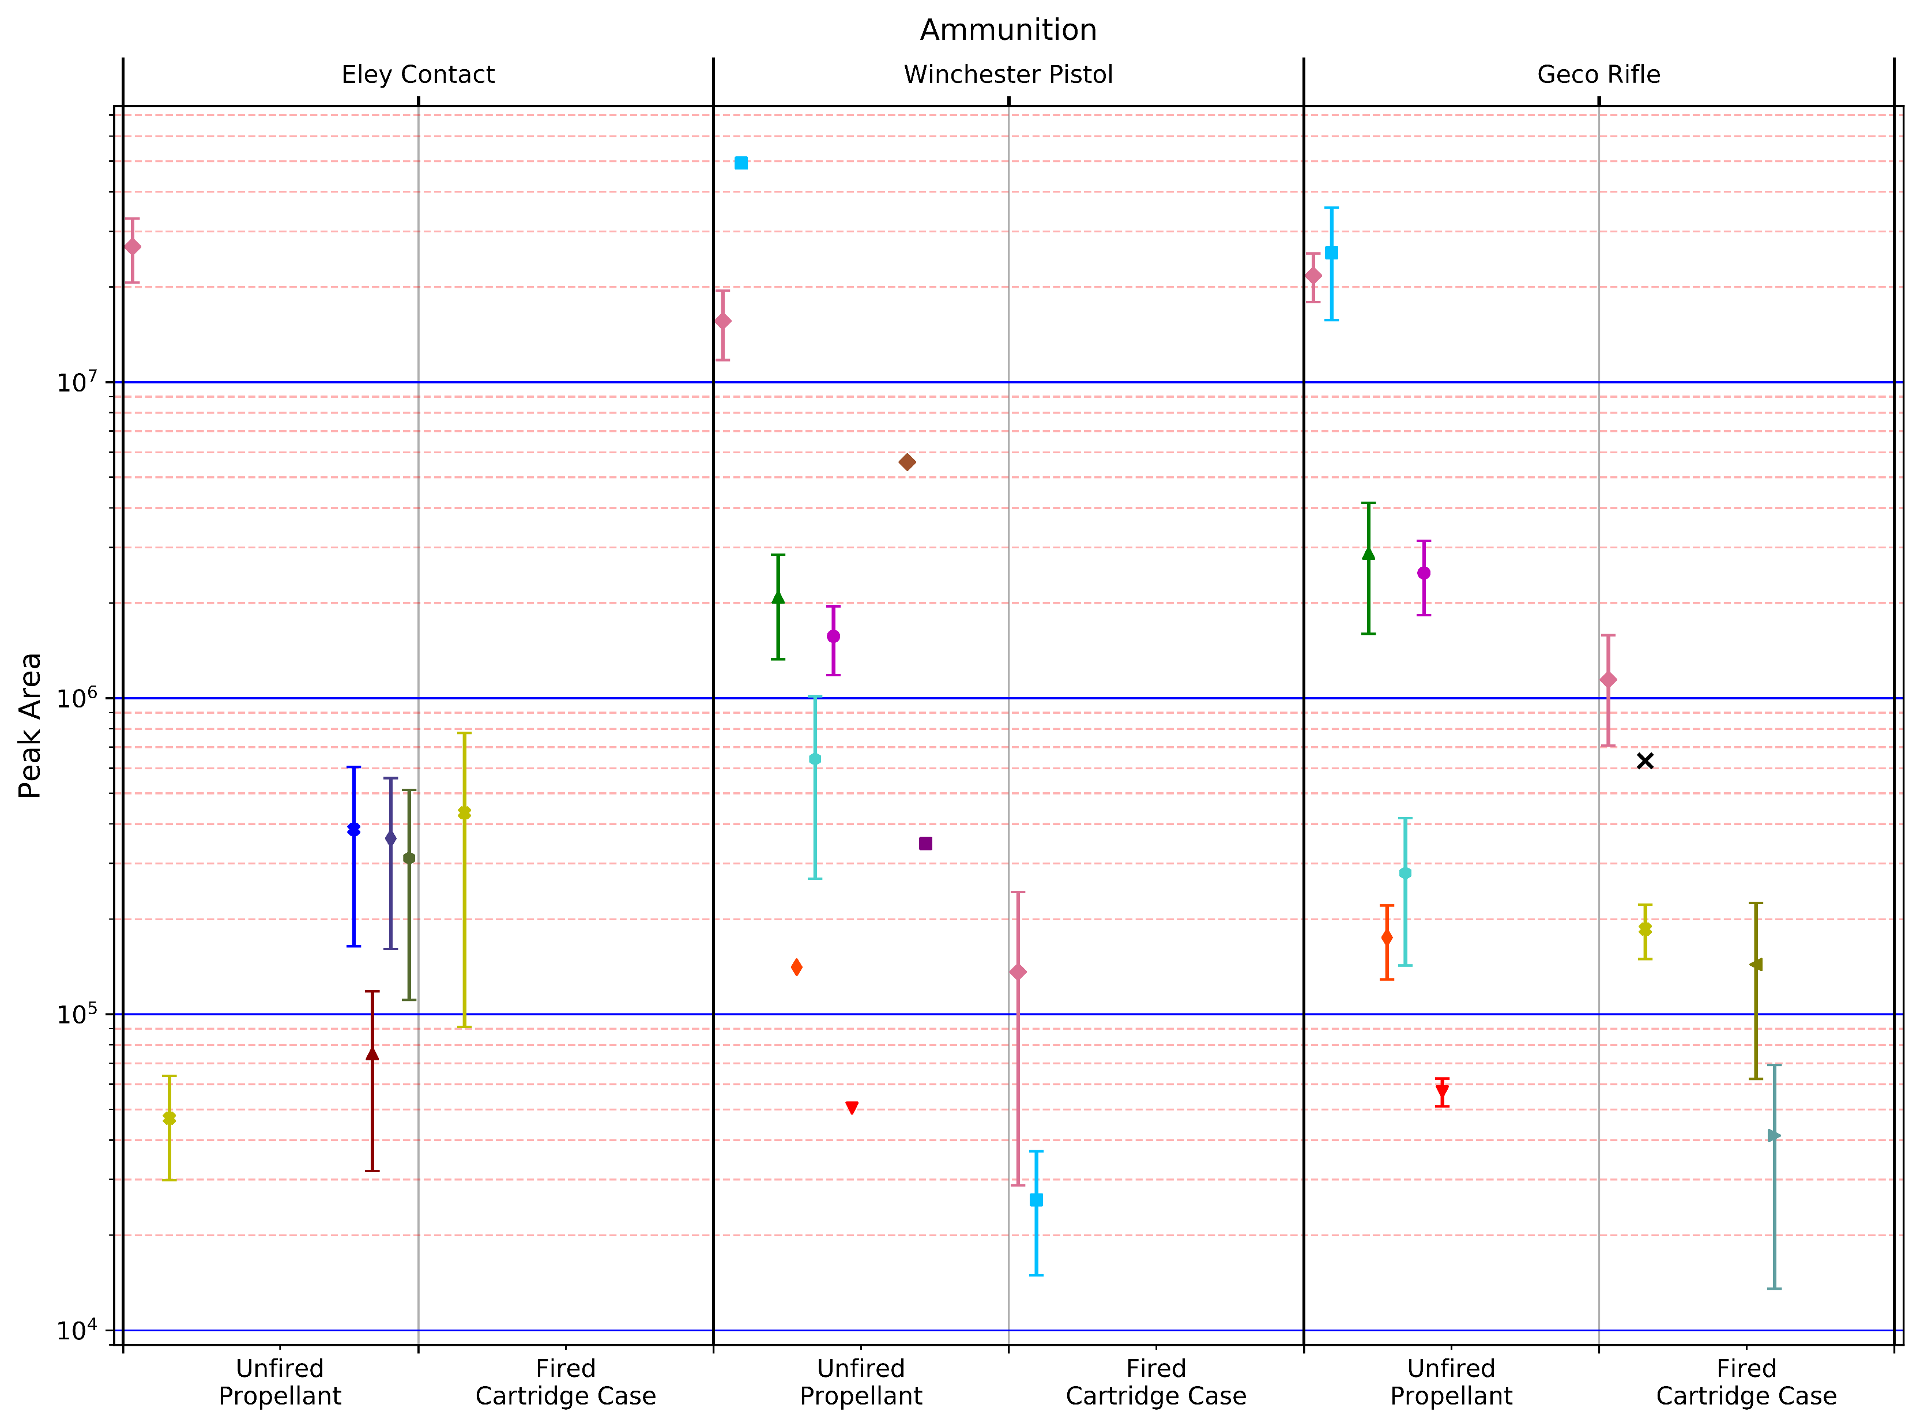
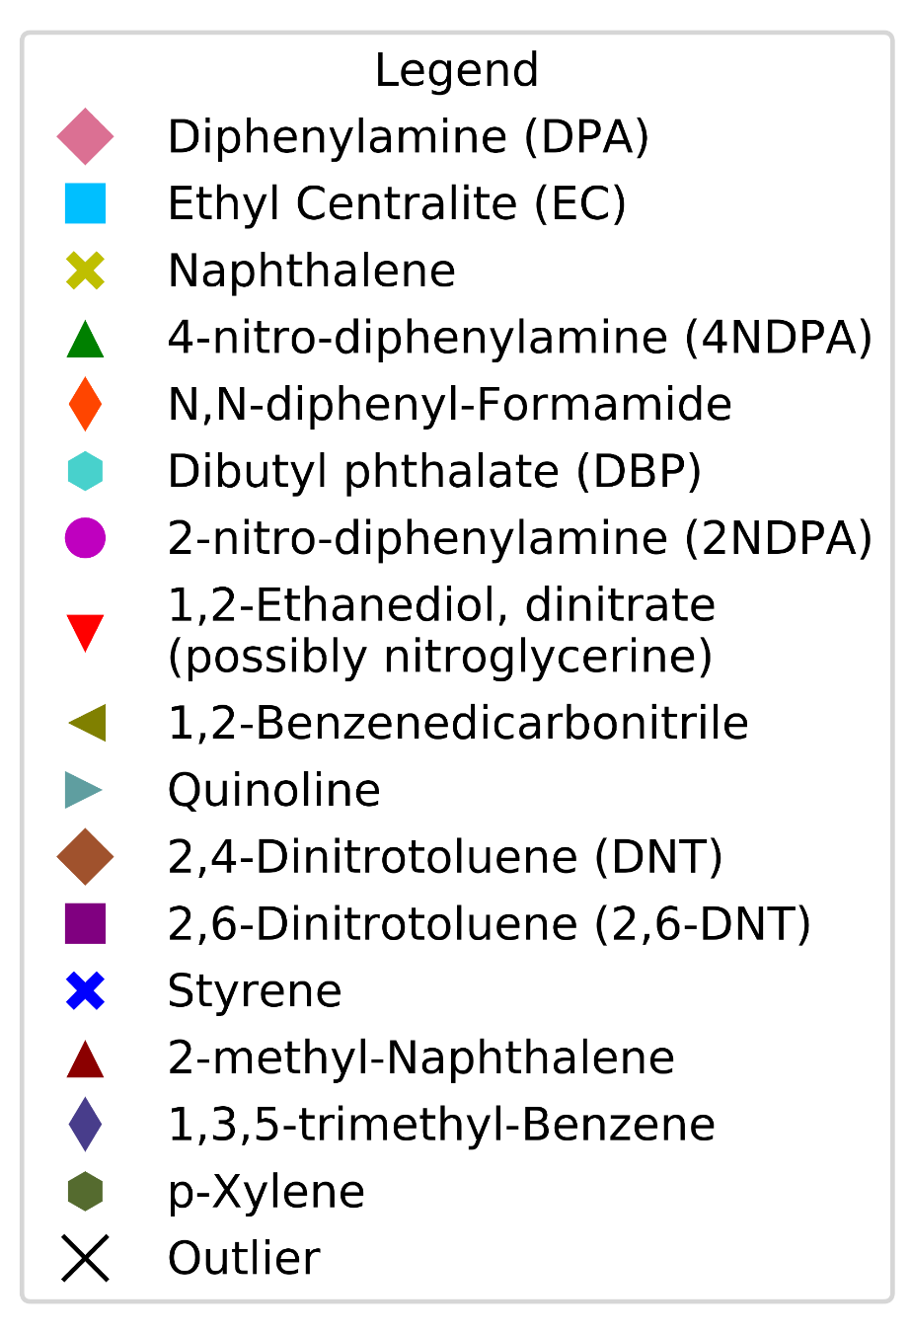
Results
Notes:
(0) This graph shows profiles for the three propellants and GSR samples.
(1) The composition of the Eley Contact propellant is distinct from the other two.
Winchester Pistol and Geco Rifle contain similar compounds, but in different concentrations, …
(2) …and Winchester Pistol contains two additional compounds (circled).
(3) The shape of the Winchester and Geco propellants suggests that they may be double base – containing both nitroglycerine and nitrocellulose. Nitroglycerine was detected with a manual search, but was misidentified as 1,2-Ethanediol, dinitrate by the automated method.
Eley Contact was expected to be single base based on its shape, and NG was not detected in the propellant
(4) All three propellants produced GSR with different compositions. Most of the compounds present in the propellant are not present in the GSR, …
(5) …but there are some additional compounds present in the Geco GSR. These may be breakdown products of compounds in the propellant, or could be compounds from the primer or cartridge case
(6) The concentration of naphthalene also increased from the Eley Propellant to the GSR, possibly for the same reasons.

Slide 10
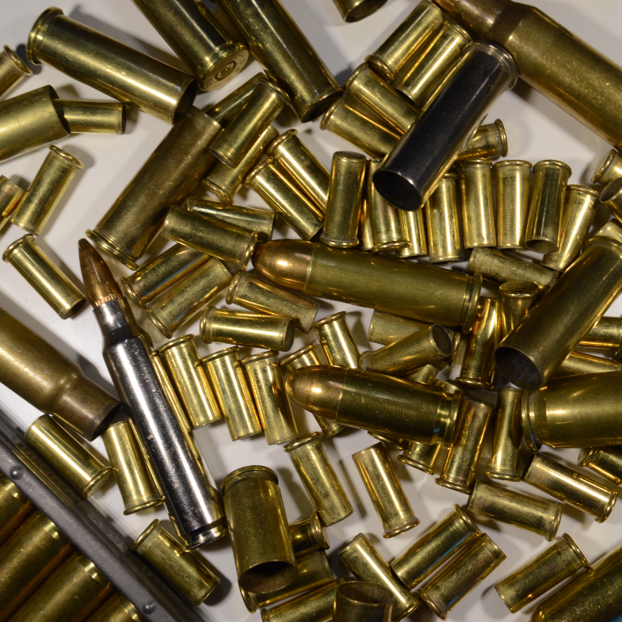
Results
Complete list of compounds detected can aid in identification
Identifications are not conclusive
Analysis of standards required
Notes:
(0) The analysis mainly focused on compounds previously reported in literature as being present in propellant.
(1) Other compounds were detected in the propellant and GSR, and these can be used to further differentiate the samples
(2) Identifications of compounds were only made by comparisons to the NIST Mass Spectra database, and so are not conclusive.
(3) Standards for the compounds would have to be analysed to confirm the identification
<discuss the standards already analysed>

Slide 11
Further Work
Method should work with other brands and calibres of ammunition
Could be used to develop a database to identify the source of propellant
Potential use with other evidence types
Controlled substances
Alcohol
Paint
Notes:
The methods used in this experiment should work with propellant and GSR samples from other brands and calibres of ammunition,…
…and could be used to develop a database to allow the source of propellant to be determined from the GSR.
Other criteria, such as dimensions of the cartridge case or the physical properties of the propellant, could also be included.
(3) “GunShotMatch” could also be useful for profiling minor additives in other samples, such as cutting agents in controlled substances, and ingredients in beer and paint.
Beer: http://news.bbc.co.uk/1/hi/business/4942262.stm

Slide 12
Conclusion
The three brands had different chemical composition of the propellant
The three brands produced GSR with different compositions
There was no consistent relationship between the propellant and GSR
Notes:
The three brands of ammunition analysed could be distinguished based on the physical characteristics and chemical composition of the propellant
(2) The three brands produced GSR with different compositions
(3) There was no consistent, predictable relationship between the propellant and GSR; the concentration of some compounds increased while the concentration of others decreased

Slide 13
Acknowledgements
Thanks to Michael Cutler, Chris Davis-Foster, Simon Rees, Jim Cooper and Jack Gibbard of Marlow Rifle and Pistol Club for their assistance with preparing the propellant and GSR samples.
Thanks to my supervisor, Dr Rachel Bolton-King, and to Dr Alison Davidson for assistance with the analysis.
Notes:
Thanks to everybody who helped with the practical elements of the project and the development of “GunShotMatch”.

Slide 14
Questions?

Slide 15

Identifying the brand of ammunition from gunshot residue
✉ dominic@davis-foster.co.uk
🌐 dominic.davis-foster.co.uk/gsr
@DDFoster96
Dominic Davis-Foster
MSci Forensic Science
Staffordshire University
Notes:
References:
Dalby, O. (2011) The Analysis of Organic Ballistic Materials. Nottingham Trent University. Available at: http://irep.ntu.ac.uk/id/eprint/326/.
Dalby, O. and Birkett, J. W. (2010) ‘The evaluation of solid phase micro-extraction fibre types for the analysis of organic components in unburned propellant powders’, Journal of Chromatography A, 1217(46), pp. 7183–7188. doi: 10.1016/j.chroma.2010.09.012.
ELEY Ltd (2014) ‘rimfire eley 22.jpg’. Available at: http://files.forensicmed.webnode.com/200000260-1ca931da31/rimfire eley 22.jpg (Accessed: 27 February 2018).
Hofstetter, C., Maitre, M., Beavis, A., Roux, C. P., et al. (2017) ‘A study of transfer and prevalence of organic gunshot residues’, Forensic Science International, 277, pp. 241–251. doi: 10.1016/j.forsciint.2017.06.013.
Mach, M. H., Pallos, A. and Jones, P. F. (1978) ‘Feasibility of Gunshot Residue Detection Via Its Organic Constituents. Part I: Analysis of Smokeless Powders by Combined Gas Chromatography-Chemical Ionization Mass Spectrometry’, Journal of Forensic Sciences, 23(3), p. 10690J. doi: 10.1520/JFS10690J.
McCord, B. R. and Bender, E. C. (1998) ‘Chromatography of Explosives’, in Beveridge, A. (ed.) Forensic Investigation of Explosives. London: Taylor & Francis.
Mike George (2017) Is the rimfire .22 long rifle cartridge the top seller in the UK?, Shooting UK. Available at: http://www.shootinguk.co.uk/guns/ammunition/22-long-rifle-97039 (Accessed: 26 February 2018).
Selavka, C. M., Strobel, R. A. and Tontarski, R. E. (1989) ‘The Systematic identification of Smokeless Powders: An Update’, in Proceedings of the Third Symposium on the Analysis and Detection of Explosives. Berghausen, DE: Fraunhofer Institute fur Chemische Technologie.
Wallace, J. S. (2008) Chemical Analysis of Firearms, Ammunition, and Gunshot Residue. Boca Raton, FL: CRC Press.
Warlow, T. A. (2007) ‘The criminal use of improvised and re-activated firearms in Great Britain and Northern Ireland’, Science & Justice, 47(3), pp. 111–119. doi: 10.1016/j.scijus.2006.10.003.
Wilson, J. D., Tebow, J. D. and Moline, K. W. (2003) ‘Time since discharge of shotgun shells.’, Journal of Forensic Sciences, 48(6), pp. 1298–301. Available at: http://www.ncbi.nlm.nih.gov/pubmed/14640274 (Accessed: 9 October 2017).
Wrobel, H. A., Millar, J. J. and Kijek, M. (1998) ‘Identification of Ammunition from Gunshot Residues and Other Cartridge Related Materials — A Preliminary Model Using .22 Caliber Rimfire Ammunition’, Journal of Forensic Sciences, pp. 324–328.

